Slide 1
Swiggy Case Dataset - Pre-Post Diwali Sales

Slide 2
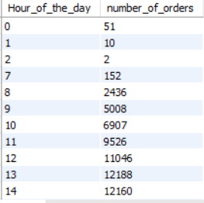
Hour wise number of order (Pre)
Query:
select Hour_of_the_day, count(id) from pre_datagroup by Hour_of_the_dayorder by 1;
Sample Output:

Slide 3
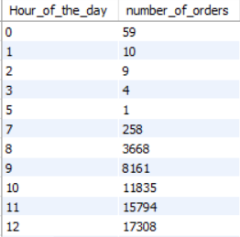
Hour wise number of order (Post)
Query:
select Hour_of_the_day, count(id) as number_of_orders from post_datagroup by Hour_of_the_dayorder by 1;
Sample Output:

Slide 4
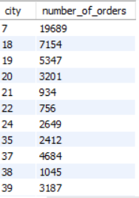
City wise total number of order (Pre)
Query:
select city, count(id) as number_of_orders from pre_datagroup by cityorder by 1;
Sample Output:

Slide 5
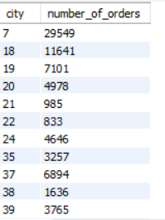
City wise total number of order (Post)
Query:
select city, count(id) as number_of_orders from post_datagroup by cityorder by 1;
Sample Output:

Slide 6
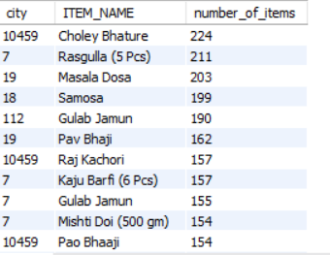
City wise which product is more popular (Pre)
Query:
select city, ITEM_NAME, count(ITEM_Name) as number_of_items from pre_datagroup by city,ITEM_NAMEhaving count(ITEM_Name)>1order by 3 desc;
Sample Output:

Slide 7
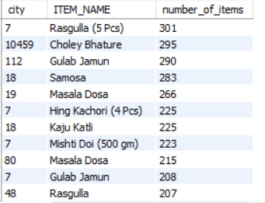
City wise which product is more popular (Post)
Query:
select city, ITEM_NAME, count(ITEM_Name) as number_of_items from post_datagroup by city,ITEM_NAMEhaving count(ITEM_Name)>1order by 3 desc;
Sample Output:

Slide 8
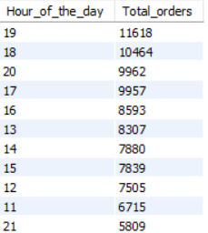
Hour wise total number of order where Qty more than 1 (Pre)
Query:
select Hour_of_the_day, sum(ORDERS) as Total_orders from pre_datawhere QTY>1group by Hour_of_the_dayorder by 2 desc;
Sample Output:

Slide 9
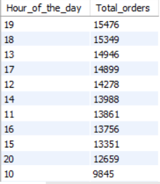
Hour wise total number of order where Qty more than 1 (Post)
Query:
select Hour_of_the_day, sum(ORDERS) as Total_orders from post_datawhere QTY>1group by Hour_of_the_dayorder by 2 desc;
Sample Output:

Slide 10
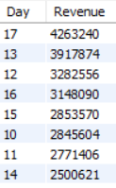
Daily Revenue and find top most (Pre)
Query:
select day(str_to_date(Date, '%d-%m-%Y')) as Day, sum(ITEM_GMV) as Revenuefrom pre_data group by day(str_to_date(Date, '%d-%m-%Y'))order by 2 desc;
Sample Output:

Slide 11
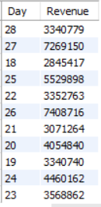
Daily Revenue and find top most (Post)
Query:
select left(Date,2) as Day, sum(ITEM_GMV) as Revenuefrom post_data group by left(Date,2);
Sample Output:

Slide 12
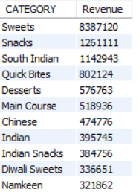
Category wise revenue (Pre)
Query:
select CATEGORY, sum(ITEM_GMV) as Revenue from pre_datagroup by CATEGORY order by 2 desc;
Sample Output:

Slide 13
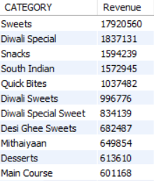
Category wise revenue (Post)
Query:
select CATEGORY, sum(ITEM_GMV) as Revenue from post_datagroup by CATEGORY order by 2 desc;
Sample Output:

Slide 14
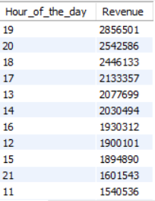
Hour wise Revenue and find top most (Pre)
Query:
select Hour_of_the_day, sum(ITEM_GMV) as Revenue from pre_datagroup by Hour_of_the_day order by 2 desc;
Sample Output:

Slide 15
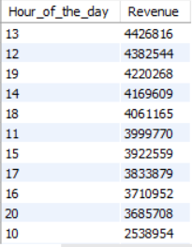
Hour wise Revenue and find top most (Post)
Query:
select Hour_of_the_day, sum(ITEM_GMV) as Revenue from post_datagroup by Hour_of_the_day order by 2 desc;
Sample Output:

Slide 16
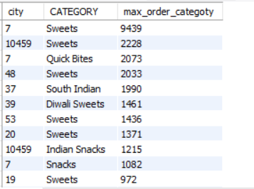
City wise famous category (Pre)
Query:
select city, CATEGORY, count(CATEGORY) as max_order_categoty from pre_datagroup by city,CATEGORYorder by 3 desc;
Sample Output:

Slide 17
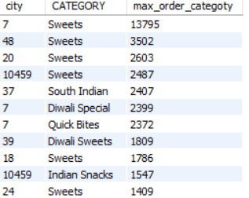
City wise famous category (Post)
Query:
select city, CATEGORY, count(CATEGORY) as max_order_categoty from post_datagroup by city,CATEGORYorder by 3 desc;
Sample Output:

Slide 18
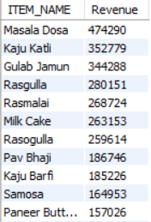
Item wise revenue and find the top most (Pre)
Query:
select ITEM_NAME, sum(ITEM_GMV) as Revenue from pre_datagroup by ITEM_NAMEorder by 2 desc;
Sample Output:

Slide 19
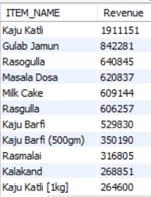
Item wise revenue and find the top most (Post)
Query:
select ITEM_NAME, sum(ITEM_GMV) as Revenue from post_datagroup by ITEM_NAMEorder by 2 desc;
Sample Output:

Slide 20
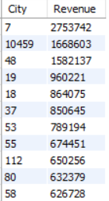
City wise revenue and find top most (Pre)
Query:
select City, sum(ITEM_GMV) as Revenue from pre_datagroup by Cityorder by 2 desc;
Sample Output:

Slide 21
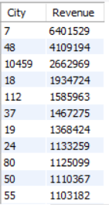
City wise revenue and find top most (Post)
Query:
select City, sum(ITEM_GMV) as Revenue from post_datagroup by Cityorder by 2 desc;
Sample Output:

Slide 22
Thank You

